Slide 1
Continuous random variables

Slide 2
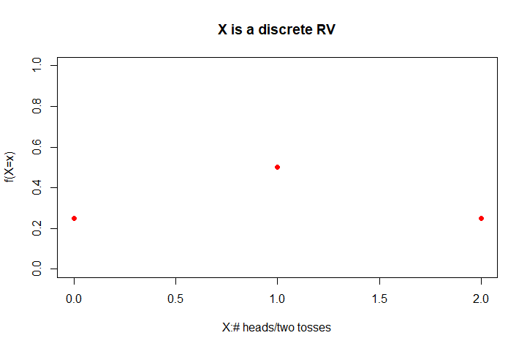

Probability accounting for discrete RV’s
For a discrete RV, the total probability mass (=1.0) is distributed to countably many points. Thus, we can tabulate the probability of its distribution “point-by-point”
$$\operatorname{Pr}\left(X=x\right)=0. 25 for x=0 and 2$$
$$\operatorname{Pr}\left(X=x\right)=0.5 for x=1$$
$\operatorname{Pr}\left(X=x\right)$=0 elsewhere

Slide 3
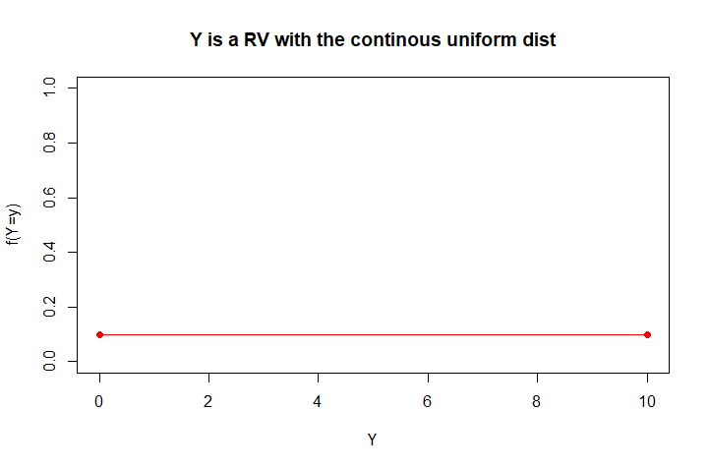

Probability for continuous RV’s
Bc a continuous RV can take on uncountably many values, the probability of $\operatorname{Pr}\left(Y=y\right)=0$ for any arbitrary $y$ (since we must spread the probability mass (=1) to unaccountably many points).
Probability for a continuous RV is defined over a range of values and is measured by the area under the density curve
Notes:
The probability (mass) can only be meaningfully defined for an interval of values, based on the idea of measuring mass by probability density × length of the interval—which is equal to the area under the probability density
While the RV can only take value between zero and ten, the probability of a single point is zero, because there are uncountably many points between zero and ten

Slide 4
Probability for continuous RV’s
The f(x) is now called the probability density function (pdf)
The f(x) value is not probability. Instead, it reflects the relative likelihood of the values over a range and it is scaled to make the total area under the curve = 1.0
Notes:
The probability (mass) can only be meaningfully defined for an interval of values, based on the idea of measuring mass by probability density × length of the interval—which is equal to the area under the probability density
While the RV can only take value between zero and ten, the probability of a single point is zero, because there are uncountably many points between zero and ten

Slide 5
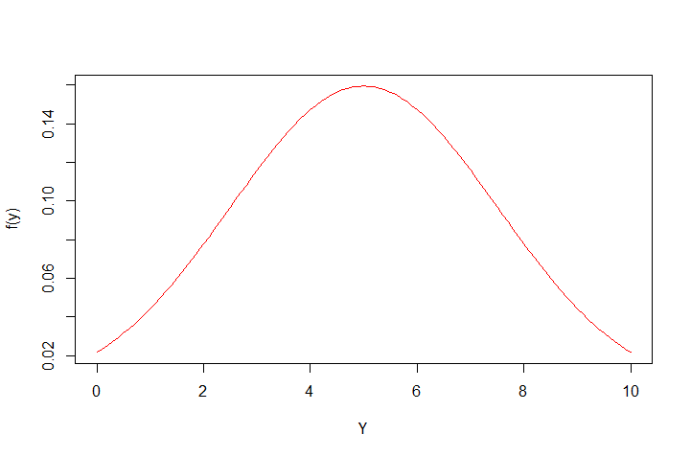
Normal distributions (Gaussian distribution)

Slide 6

Basic properties of p.d.f. and c.d.f. for continuous distributions
$⇒$ $f\left(x\right)$ must be nonnegative for any $x$
$⇒$ $F\left(x\right)$ is nondecreasing in $x$, and will be 1 when $x→∞$

Slide 7
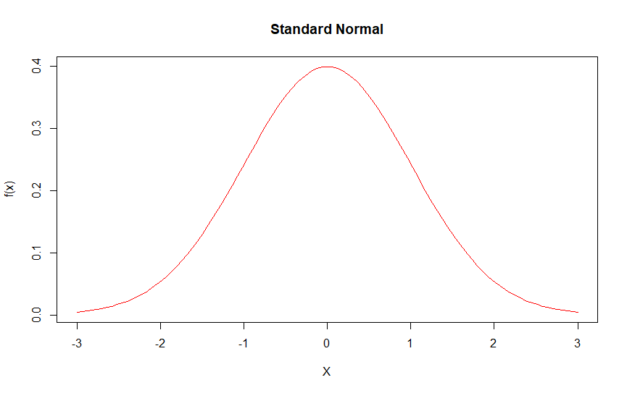

R commands for random variables
f(1)=dnorm(1, mean = 0 , sd = 1 ) $=0.2419707$
F(-1)=pnorm(-1, mean = 0 , sd = 1 ) $=0.1586553$

Slide 8
Example: Normal distributions
X follows a standard normal distribution. (a) Show graphically the probability that X<1. (b) Calculate its probability
(b)
>pnorm(1,0,1)
=0.8413447

Slide 9
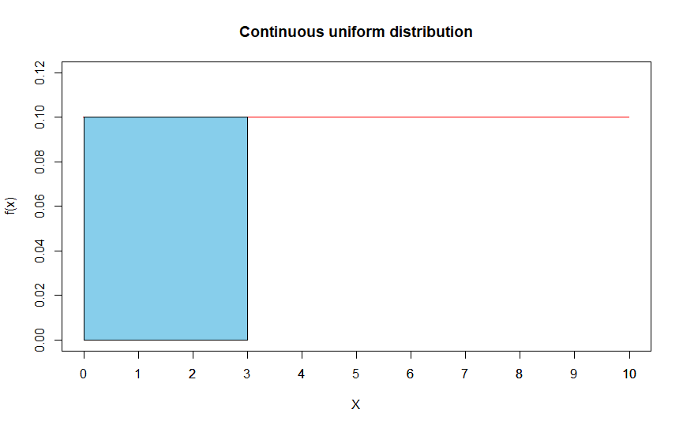
Example: Continuous uniform distributions
X is uniformly distributed over [0, 10]. calculate the probability that (a) X<=3, (b) X>=7, (c) 1<=X<=6
Pr(X<=3) can be found using the command
punif(x, min = a, max = b).
>punif(3, min = 0, max = 10)
=0.3

Slide 10
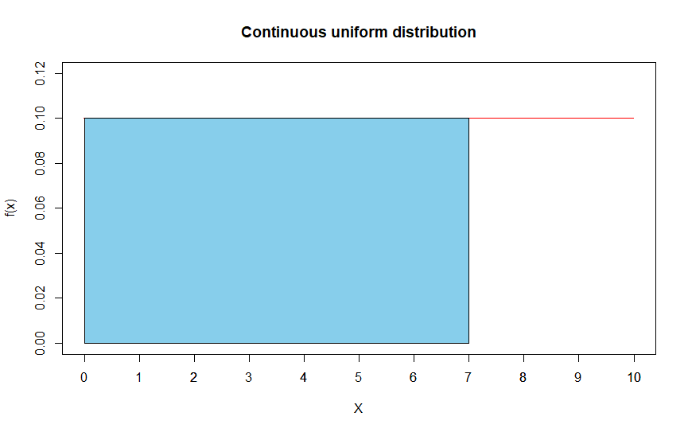
Example: Continuous uniform distributions
X is uniformly distributed over [0, 10]. calculate the probability that (a) X<=3, (b) X>=7, (c) 1<=X<=6
(b)
>1-punif(7, min = 0, max = 10)
=0.3

Slide 11
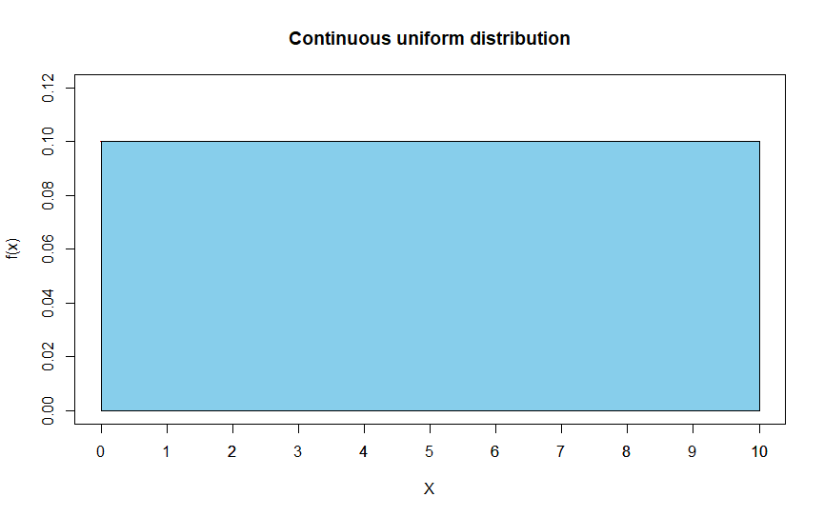
Example: Continuous uniform distributions
X is uniformly distributed over [0, 10]. calculate the probability that (a) X<=3, (b) X>=7, (c) 1<=X<=6
(b)
>punif(6, min = 0, max = 10) - punif(1, min = 0, max = 10)
=0.5

